Slide 1


<Panagiotis Prassas>
<27 July 2024>

Slide 2

Outline
Executive Summary
Introduction
Methodology
Results
Conclusion
Appendix

Slide 3
Executive Summary
Summary of methodologies:
Data Collection with API & Web Scraping
Data Wrangling
Exploratory Data Analysis (EDA) using SQL
Exploratory Data Analysis (EDA) with Data Visualization
Interactive Visual Analytics with Folium
Building an Interactive Dashboard with Plotly Dash
Machine Learning (ML) Prediction
Summary of all results
It was possible to collected valuable data from public sources
EDA allowed to identify which of the features are the best ones in order to predict success of landings
ML Prediction results showed which model is the best in order to predict which characteristics are crucial to drive this opportunity by the best way, by using all the data that have been collected

Slide 4
Introduction
Project background and context
In this capstone, we will predict if the Falcon 9 first stage will land successfully. SpaceX advertises Falcon 9 rocket launches on its website, with a cost of 62 million dollars; other providers cost upward of 165 million dollars each, much of the savings is because SpaceX can reuse the first stage. Therefore if we can determine if the first stage will land, we can determine the cost of a launch. This information can be used if an alternate company wants to bid against SpaceX for a rocket launch
So the main objective is to evaluate the viability of a new company named SpaceY to compete with SpaceX
Problems you want to find answers
How do variables such as payload mass, launch site, number of flights, and orbits affect the success of the first stage landing?
What is the best algorithm that can be used for binary classification in this case?
Where is the best place in order to perform the launches

Slide 5

Section 1

Slide 6
Methodology
Executive Summary
Data collection methodology:
Data was collected from 2 public sources:
SpaceX API (https://api.spacexdata.com/v4/rockets/)
Web Scraping (https://en.wikipedia.org/wiki/List_of_Falcon/_9/_and_Falcon_Heavy_launches)
Perform data wrangling
Collected data structured based on a landing outcome after analyzing features
Perform exploratory data analysis (EDA) using visualization and SQL
Perform interactive visual analytics using Folium and Plotly Dash

Slide 7
Methodology
Executive Summary
Perform predictive analysis using classification models
Collected Data after Wrangling, EDA and Visualization, then it was divided in training and test datasets and was evaluated by 4 different classification models (Logistic Regression, SVM, KNN, Decision Tree) and each accuracy of these models was evaluated by using different combinations of parameters

Slide 8
Data Collection
Data was collected from :
SpaceX: https://api.spacexdata.com/v4/rockets/ (API used)
Wikipedia: https://en.wikipedia.org/wiki/List_of_Falcon/_9/_and_Falcon_Heavy_launches (Web Scraping used)

Slide 9
Data Collection – SpaceX API
SpaceX provides a public API from where data can be obtained(https://api.spacexdata.com/v4/rockets/)
Link to the notebook: https://github.com/PanagiotisPrassas/IBM_Applied_Data_Science_Capstone/blob/main/01.Data%20Collection%20API.ipynb
Request launch data from API
Decode response using .json
Apply custom functions
Replace Missing Values
Filter Data (only Falcon9 launches)
Construct data into dictionary
Export Data to CSV

Slide 10
Data Collection – Web Scraping
Wikipedia also provides data (https://en.wikipedia.org/wiki/List_of_Falcon/_9/_and_Falcon_Heavy_launches)
Link to the notebook: https://github.com/PanagiotisPrassas/IBM_Applied_Data_Science_Capstone/blob/main/02.Data%20Collection%20with%20Web%20Scraping.ipynb
Request launch data from Wiki
Create Beautiful Soup object
Extract all column names
Create DataFrame from dictionary
Construct Data into dictionary
Collect data by parsing HTML tables
Export Data to CSV

Slide 11
Data Wrangling
We performed Exploratory Data Analysis (EDA) to the Data and we determined the training labels
We calculated the number of the launches of each site and the number of each orbits
After analyzing features, we created a landing outcome label and export all results to a CSV
Link to the notebook :
https://github.com/PanagiotisPrassas/IBM_Applied_Data_Science_Capstone/blob/main/03.Data%20Wrangling.ipynb

Slide 12
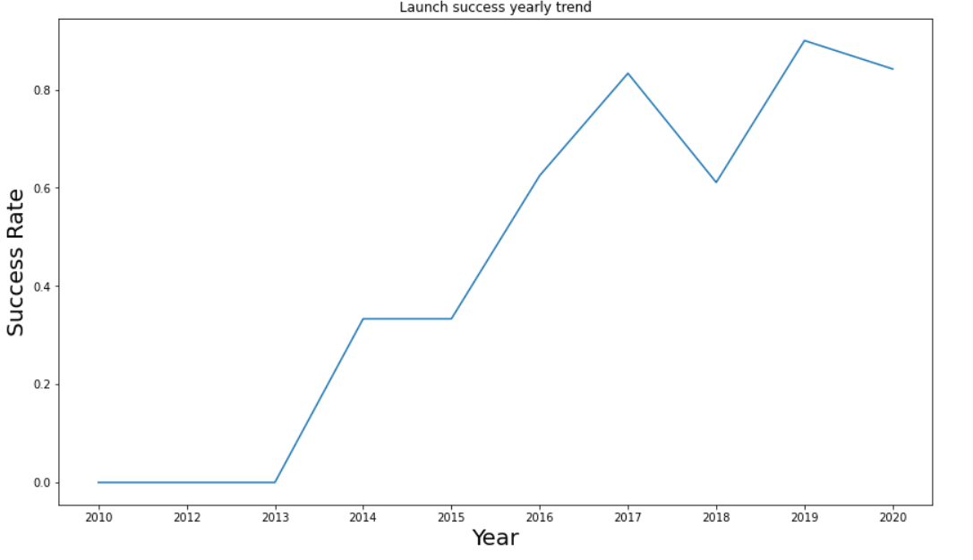
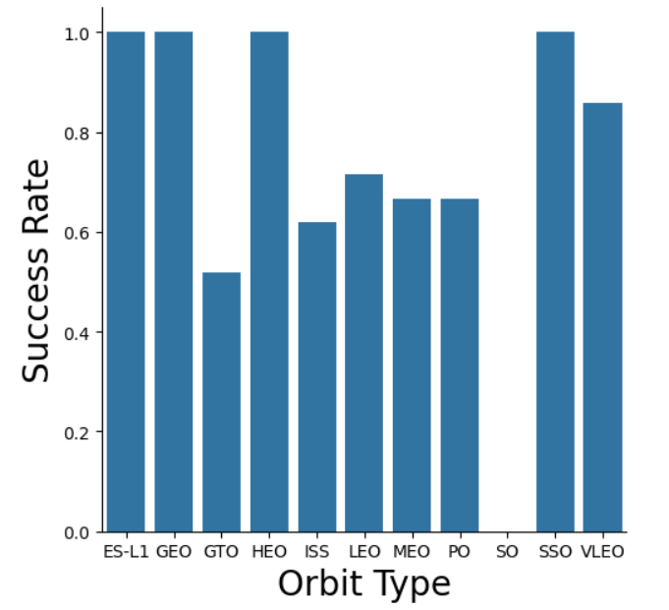
EDA with Data Visualization
We performed EDA to the data by visualizing the relationships between the features such as flight number, launch site, payload, success rate of each orbit type and launch success yearly trend
Link to the notebook : https://github.com/PanagiotisPrassas/IBM_Applied_Data_Science_Capstone/blob/main/05.Exploratory%20Data%20Analysis%20with%20Data%20Visualization.ipynb

Slide 13
EDA with SQL
We downloaded the dataset and stored it in database table
We performed SQL Queries to find out:
The names of the unique launch sites in the space mission
5 records where launch sites begin with the string 'CCA’
The total payload mass carried by boosters launched by NASA (CRS)
Average payload mass carried by booster version F9 v1.1
The date when the first successful landing outcome in ground pad was achieved
The names of the boosters which have success in drone ship and have payload mass greater than 4000 but less than 6000
The total number of successful and failure mission outcomes
The names of the booster versions which have carried the maximum payload mass

Slide 14
EDA with SQL
The failed landing outcomes in drone ship, their booster versions, and launch site names for in year 2015
Ranking the count of landing outcomes (such as Failure (drone ship) or Success (ground pad)) between the date 2010-06-04 and 2017-03-20, in descending order
Link to the notebook : https://github.com/PanagiotisPrassas/IBM_Applied_Data_Science_Capstone/blob/main/04.Exploratory%20Data%20Analysis%20with%20SQL.ipynb

Slide 15
Build an Interactive Map with Folium
We marked all launch sites, and added map objects such as markers, circles, lines to mark the success or failure of launches for each site on the folium map.
We assigned the feature launch outcomes (failure or success) to class 0 and 1.i.e., 0 for failure, and 1 for success.
Using the color-labeled marker clusters, we identified which launch sites have relatively high success rate.
Link to the notebook : https://github.com/PanagiotisPrassas/IBM_Applied_Data_Science_Capstone/blob/main/06.Interactive%20Visual%20Analystics%20with%20Folium.ipynb

Slide 16
Build a Dashboard with Plotly Dash
We built an interactive dashboard with Plotly dash
We plotted pie charts showing the total launches by a certain sites
We plotted scatter graph showing the relationship with Outcome and Payload Mass (Kg) for the different booster version.
Link to the notebook : https://github.com/PanagiotisPrassas/IBM_Applied_Data_Science_Capstone/blob/main/07.Interactive%20Dashboard%20with%20Ploty%20Dash.py

Slide 17
Predictive Analysis (Classification)
We loaded the data using NumPy and Pandas, transformed the data, split our data into training and testing
We built different machine learning models and tune different hyperparameters using GridSearchCV
We used accuracy as the metric for our model, improved the model using feature engineering and algorithm tuning
We found the best performing classification model
Link to the notebook : https://github.com/PanagiotisPrassas/IBM_Applied_Data_Science_Capstone/blob/main/08.Machine%20Learning%20Prediction%20Part.ipynb

Slide 18
Results
Exploratory data analysis results
Interactive analytics in screenshots
Predictive analysis results

Slide 19

Section 2

Slide 20
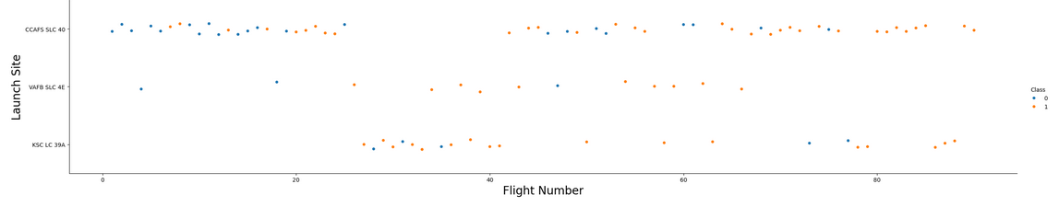
Flight Number vs. Launch Site
Explanation:
The earliest flights all failed while the latest flights all succeeded
The CCAFS SLC 40 launch site has about a half of all launches
VAFB SLC 4E and KSC LC 39A have higher success rates
It can be assumed that each new launch has a higher rate of success

Slide 21
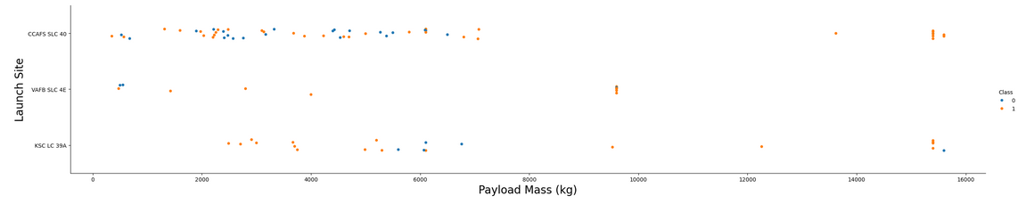
Payload vs. Launch Site
Explanation:
For every launch site the higher the payload mass, the higher the success rate
Most of the launches with payload mass over 7000 kg were successful
KSC LC 39A has a 100% success rate for payload mass under 5500 kg too

Slide 22
Success Rate vs. Orbit Type
Explanation:
Orbits with 100% success rate: - ES-L1, GEO, HEO, SSO
Orbits with success rate between 50% and 85%: - GTO, ISS, LEO, MEO, PO
Orbits with 0% success rate: - SO

Slide 23
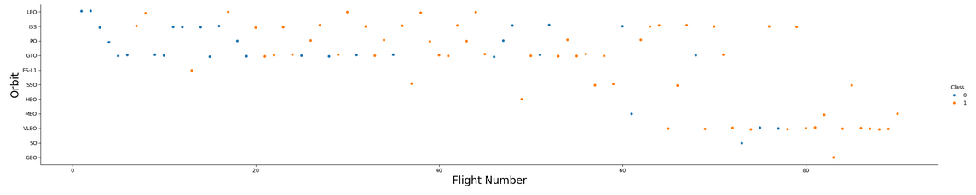
Flight Number vs. Orbit Type
Explanation:
In the LEO orbit, success is related to the number of flights whereas in the GTO orbit, there is no relationship between flight number and the orbit.

Slide 24
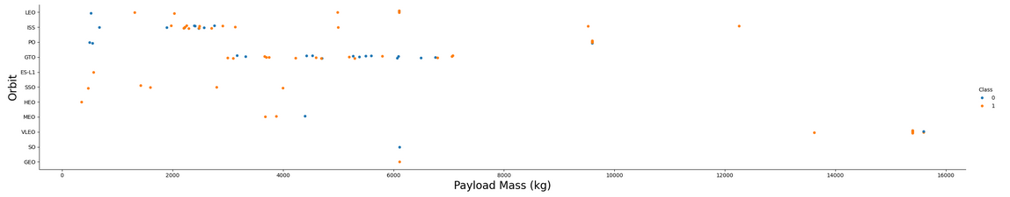
Payload vs. Orbit Type
Explanation:
With heavy payloads, the successful landing are more for PO, LEO and ISS orbits

Slide 25
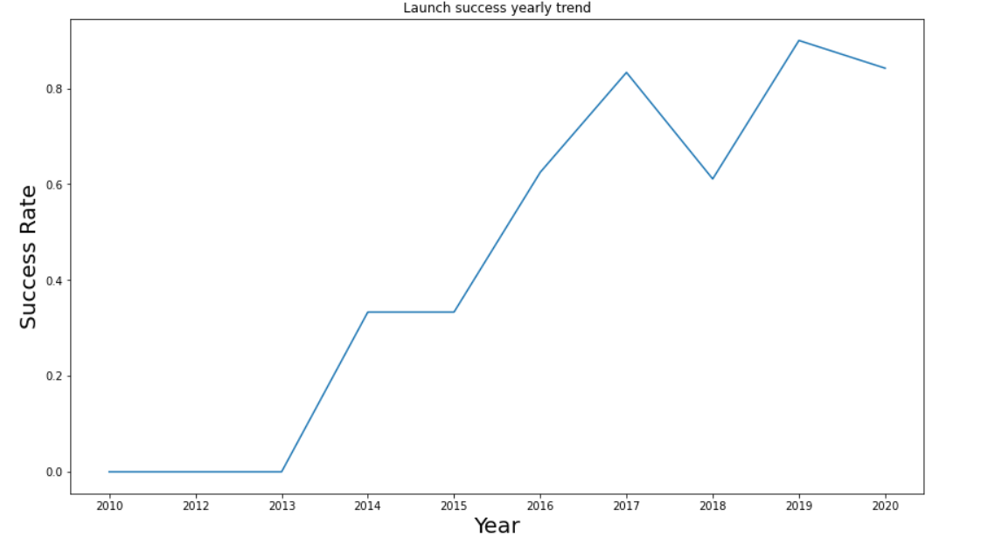
Launch Success Yearly Trend
Explanation:
The success rate since 2013 kept increasing till 2020

Slide 26
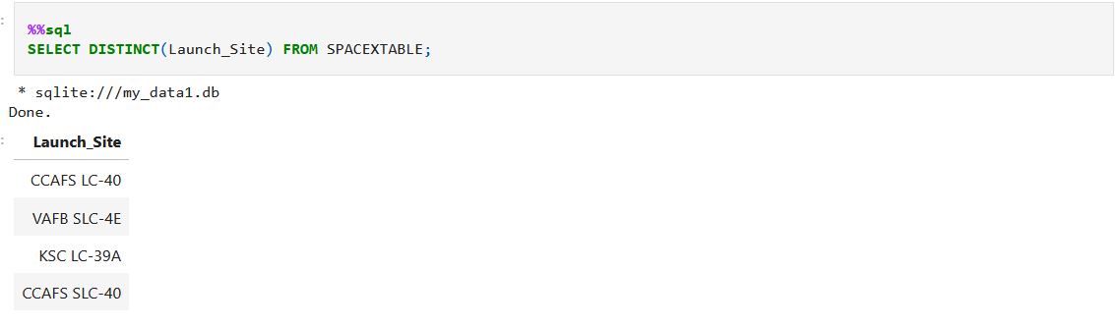
All Launch Site Names
We used DISTINCT in order to show all unique launch sites

Slide 27
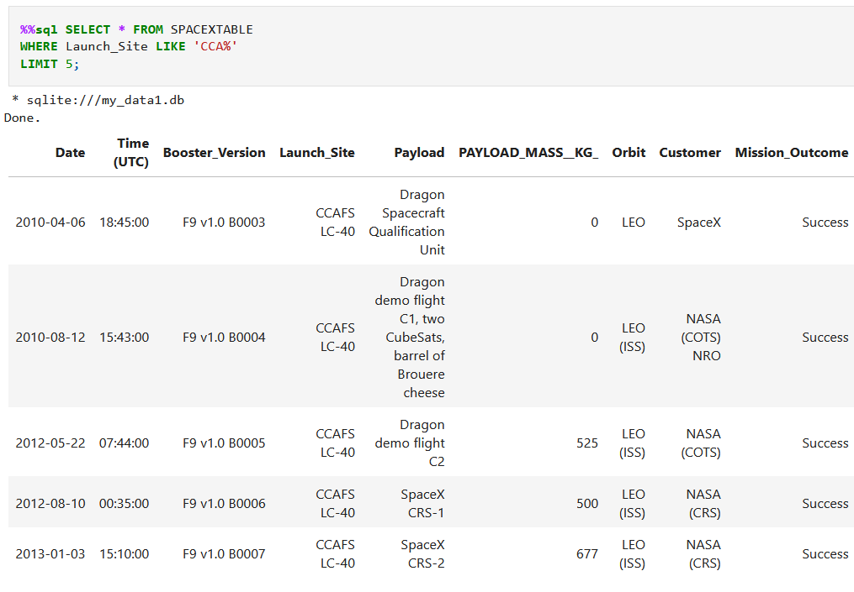
Launch Site Names Begin with 'CCA'
We performed a SQL query to display 5 records where launch sites begin with the string ‘CCA’

Slide 28
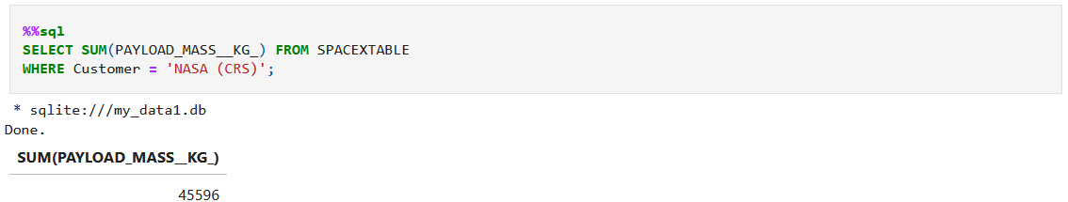
Total Payload Mass
We performed a SQL query to display the total mass carried by boosters launched by NASA (CRS)

Slide 29
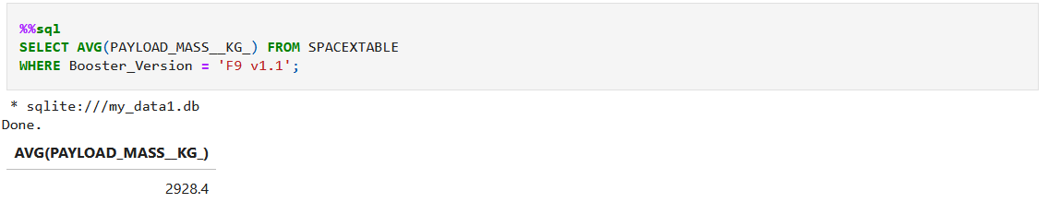
Average Payload Mass by F9 v1.1
We performed a SQL query to display the average payload mass carried by booster version F9 v1.1

Slide 30
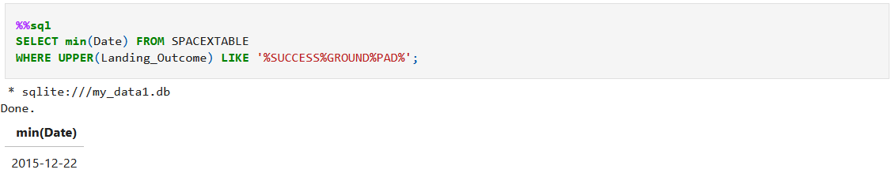
First Successful Ground Landing Date
We performed a SQL query to list the date when the first successful landing outcome in group pad was achieved

Slide 31
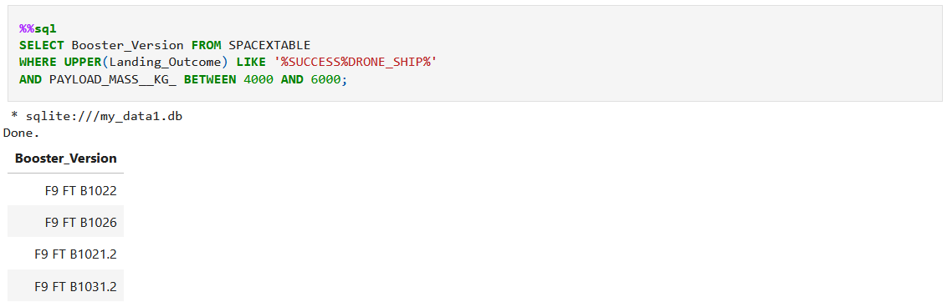
Successful Drone Ship Landing with Payload between 4000 and 6000
We used the WHERE clause to filter for boosters which have successfully landed on drone ship and applied the AND condition to determine successful landing with payload mass greater than 4000 but less than 6000

Slide 32
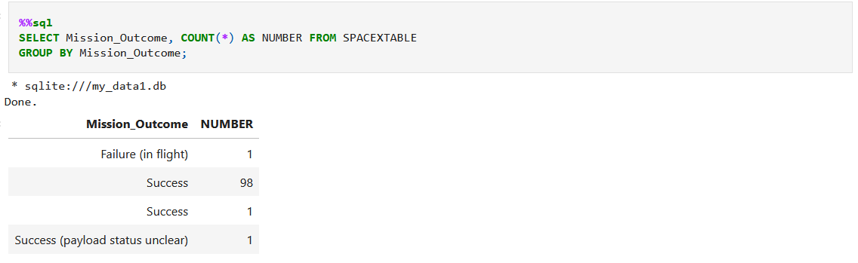
Total Number of Successful and Failure Mission Outcomes
We performed a SQL Query in order to calculate the total number of successful and failure mission outcomes

Slide 33
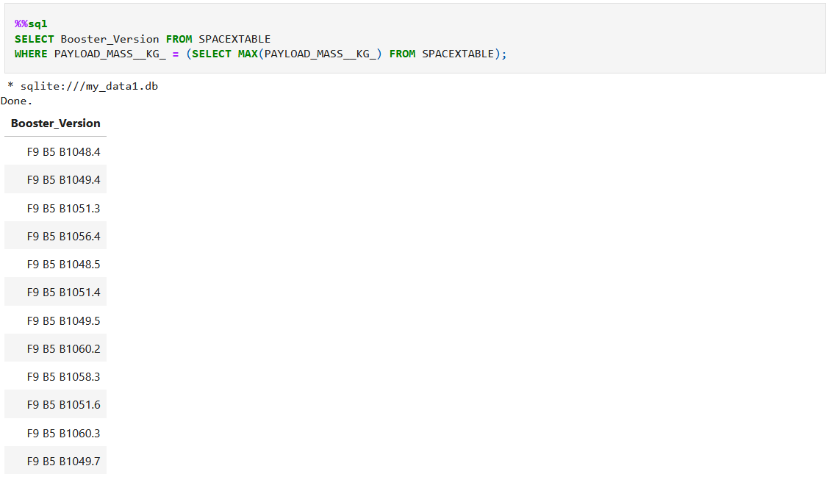
Boosters Carried Maximum Payload
We performed a SQL Query and Subquery in order to List the names of the booster versions which have carried the maximum payload mass

Slide 34
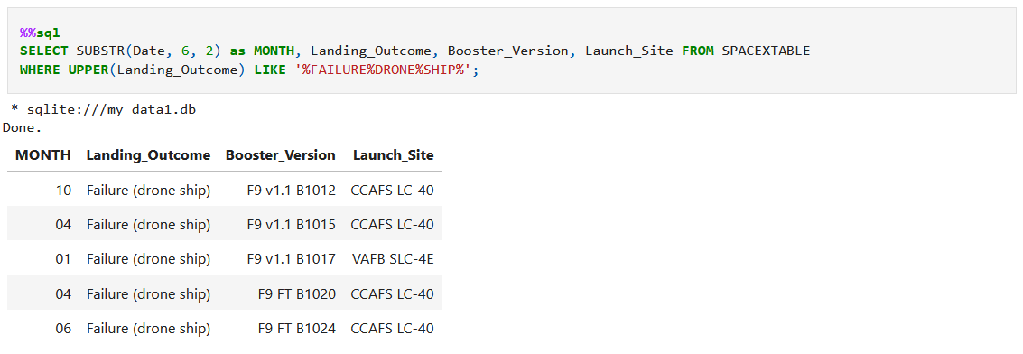
2015 Launch Records
We performed a SQL Query in order to list the failed landing outcomes in drone ship, their booster versions, and launch site names for in year 2015

Slide 35
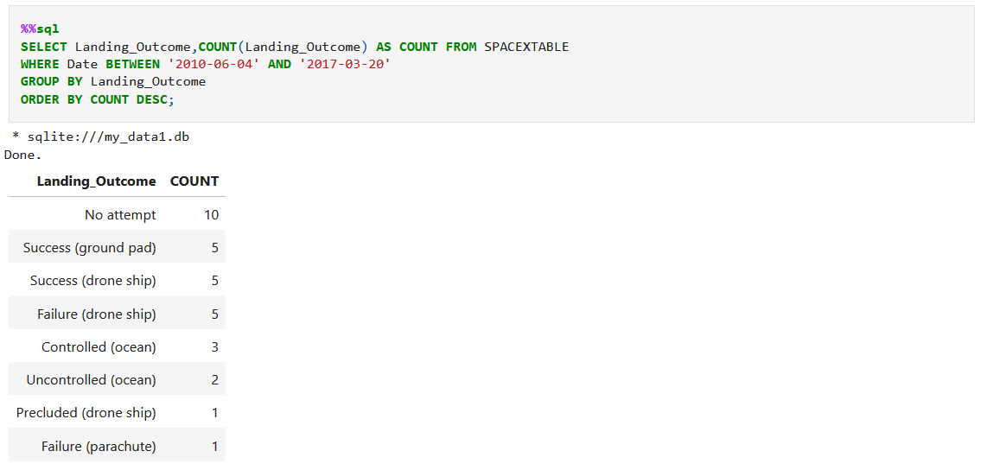
Rank Landing Outcomes Between 2010-06-04 and 2017-03-20
We performed a SQL Query in order to rank the count of landing outcomes (such as Failure (drone ship) or Success (ground pad)) between the date 2010-06-04 and 2017-03-20, in descending order

Slide 36

Section 3

Slide 37
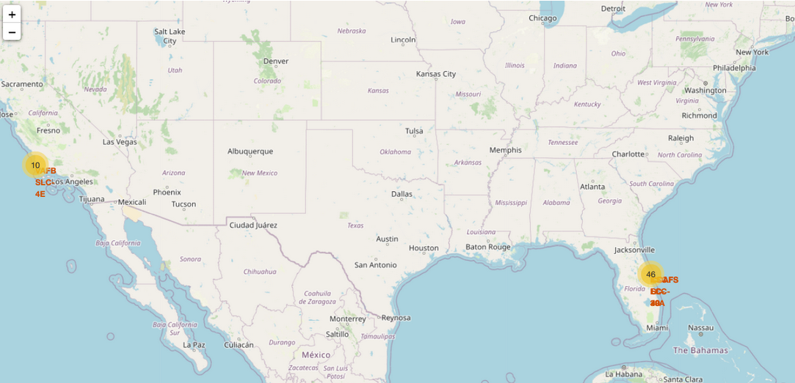
All launch sites location markers on global map
All launch sites are in very close proximity to the coast, while launching rockets towards the ocean it minimizes the risk of having any debris dropping or exploding near people.

Slide 38
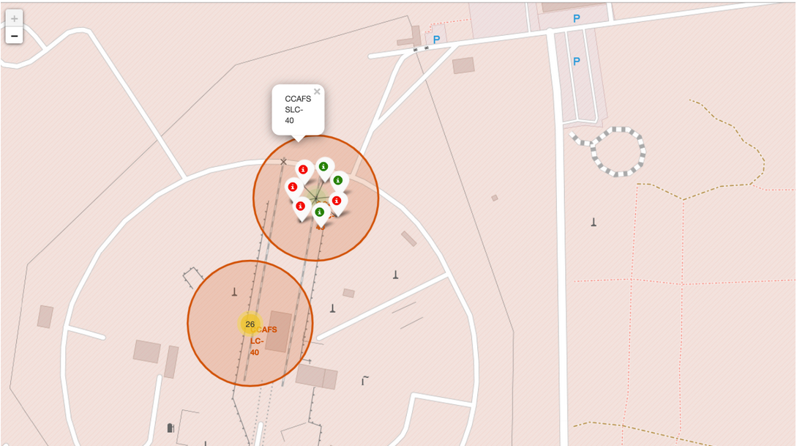
Color-labeled launch records on the map
From the color-labeled markers we should be able to easily identify which launch sites have relatively high success rates :
Green Marker = Successful Launch
Red Marker = Failed Launch

Slide 39
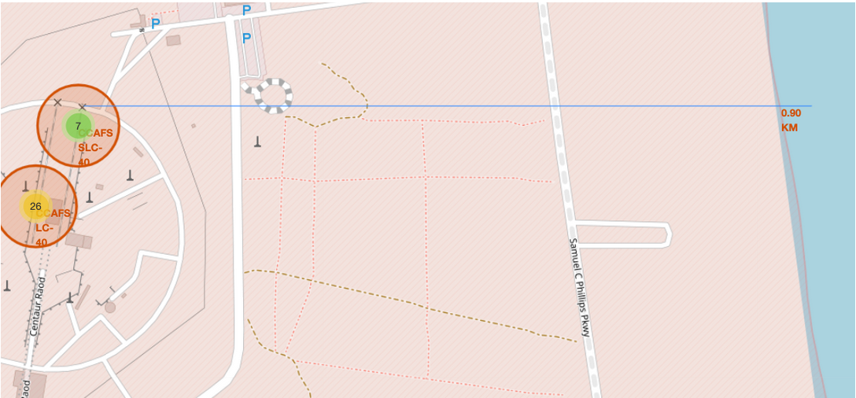
Launch Site distance to coast
From the visual analysis we can see that the AFS SLC-40 launch site is 0.90km away from the coast

Slide 40

Section 4

Slide 41
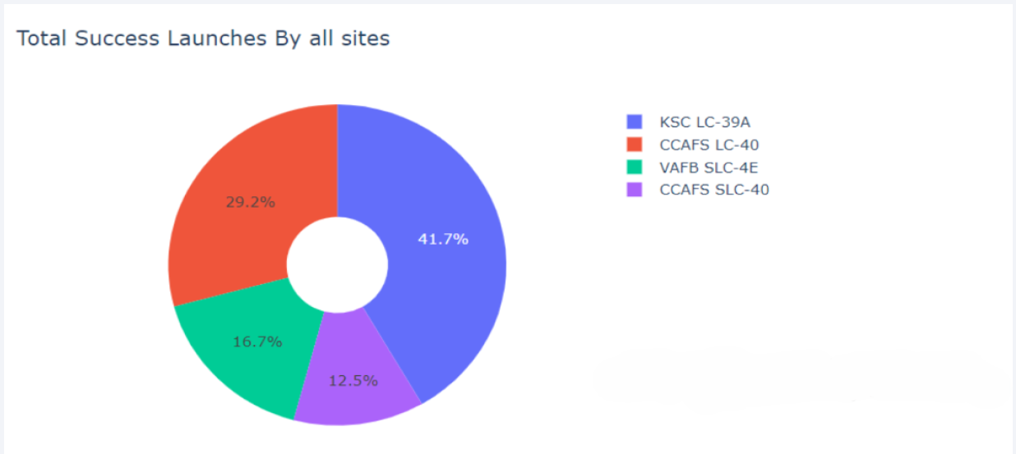
Total Success Launches By all sites
We can see that the launch site with the most successful launches is the KSC LC-39A

Slide 42
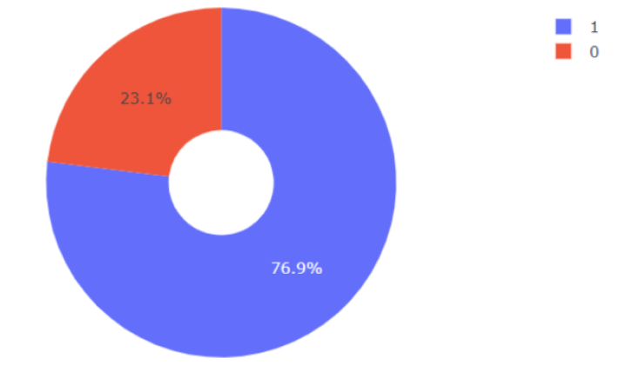
Launch site with the highest launch success ratio
KSC LC-39A, the launch site with the highest launch success ratio, achieved a 76.9% success rate along with a 23.1% failure rate

Slide 43
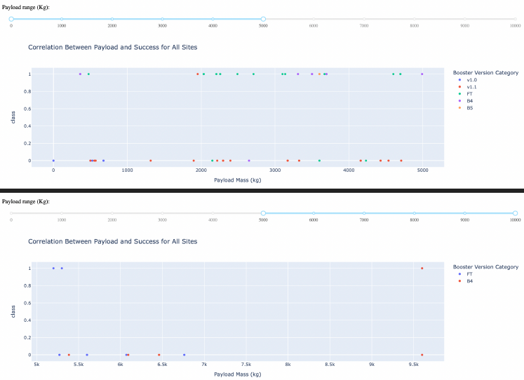
Payload vs. Launch Outcome scatter plot for all sites
Scatter plots show that payloads between 2000 and 5500 kg have the highest success rate

Slide 44

Section 5

Slide 45
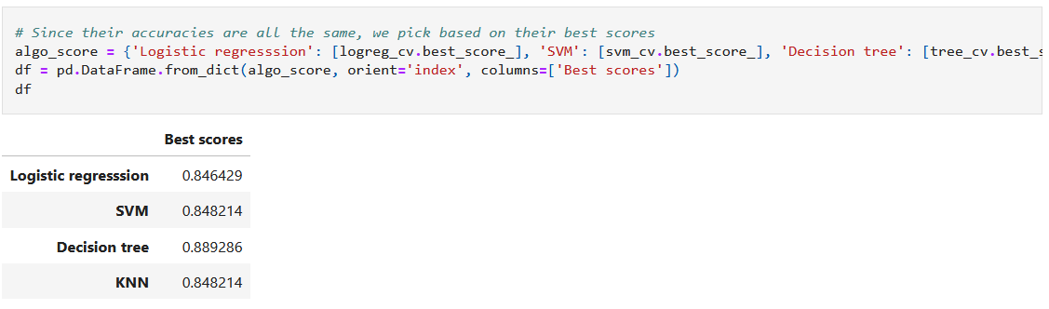
Classification Accuracy
All of the models have the same accuracy, so we performed GridSearchCV best scores in order to rank them

Slide 46

Confusion Matrix
In this visualization we show the confusion matrix of the best performing model (Decision Tree model). It visualizes that the classifier can distinguish between the different classes and the main problem is that the false positives (unsuccessful landings) are marked as successful landing by the classifier

Slide 47
Conclusions
Based on the methods used on the Data such as Wrangling, Visualization, EDA and ML we can present some interesting conclusions :
In this project, we tried to predict if the first stage of a given Falcon 9 launch will land in order to determine the cost of a launch. This information can be used if an alternate company wants to bid against SpaceX for a rocket launch. Each feature of a Falcon 9 launch, such as its payload mass or orbit type, may affect the mission outcome in a certain way such as :
The larger the flight amount at a launch site, the greater the success rate at a launch site.
Launch success rate started to increase in 2013 till 2020.
Orbits ES-L1, GEO, HEO, SSO, VLEO had the most success rate.
KSC LC-39A had the most successful launches of any sites
The Decision tree classifier is the best machine learning algorithm for this task.

Slide 48
Appendix
Source code and notebooks links from GitHub : https://github.com/PanagiotisPrassas/IBM_Applied_Data_Science_Capstone/tree/main

Slide 49


